Slide 1
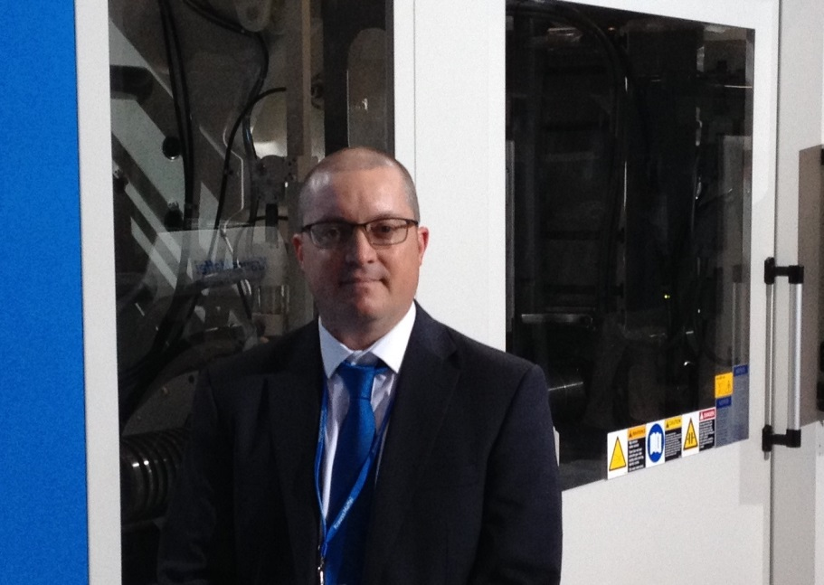
“Mold considerations when assessing robotics requirements”
Jason Holbrook
Sales Manager
Krauss Maffei Corporation
859-653-4309
Jason.holbrook@kraussmaffei.com

Slide 2
Speaker Bio:
Jason Holbrook, Sales Manager, Krauss Maffei Corporation:
Jason started his career with Worthington Custom Plastics following his graduation with a B.Sc. in Engineering Technology & Mgt. from Ohio University in 1995. He later joined ITW-Nifco as a Sales Engineer, managing the Toyota North America Account. In 2000 Jason joined Wittmann Battenfeld as a Regional Manager for the Mid-West. Then in 2012, Jason joined Krauss Maffei as a Sales Mgr. for Mid-West where he is presently employed today.
In his position as a Sales Manager for Krauss Maffei Jason brings with him a strong background in plastics injection machine technology and automation. His diverse experience in several key end markets including automotive, appliance, packaging, medical, & consumer, combined with 20 years of injection molding experience, provides a solid background to promote the latest in current & relevant injection molding technologies.
Insert Speaker Photo here

Slide 3
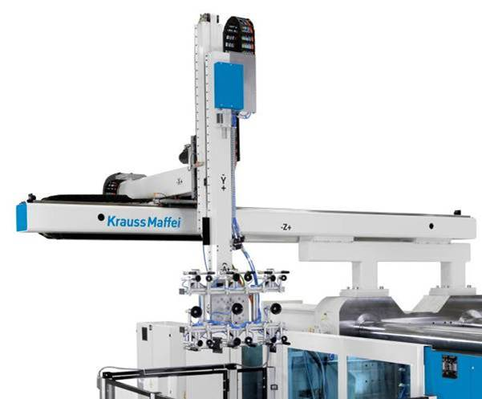
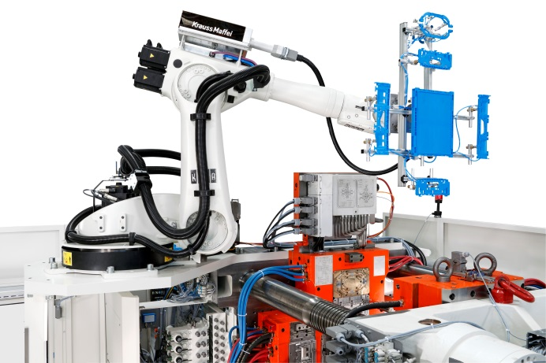
1.) Linear or Articulated Robot?
Linear:
Pro: Typically less expensive
Pro: Faster mold harvesting
Pro: Easier to program
Con: Less articulation of the part
Con: Less useful post molding
Articulated:
Pro: multifunctional
Pro: more useful post molding (value add)
Pro: can be configured for tight spaces
Con: typically more expensive
Con: typically slower part harvesting
Con: more difficult to program

Slide 4
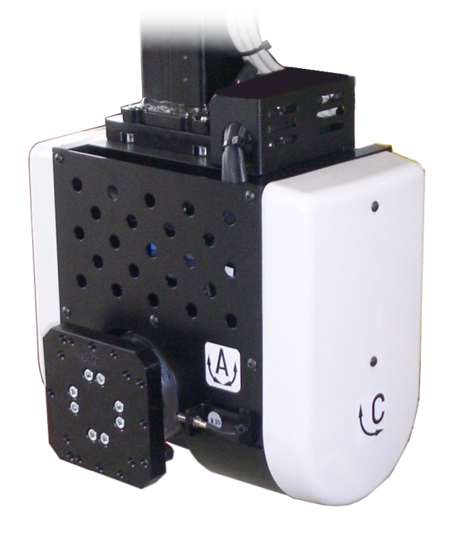
1A.) Linear or Articulated Robot – or a combination of both?
Consider your wrist options
Consider: 1.) Torque, 2.) Weight, 3.) Extra Daylight
A/C Servo Combination Wrist
Opposing Pneum. Wrist Flip

Slide 5
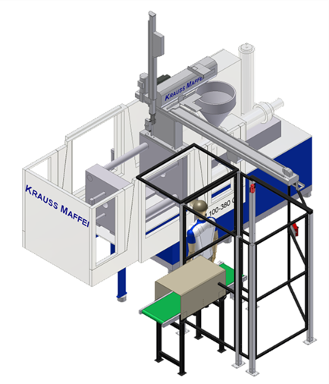
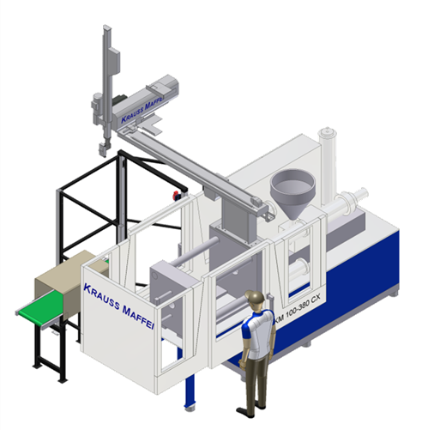
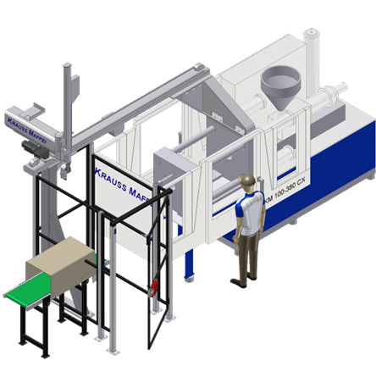
2A.) Linear Layout : Op-Side, Non-Op, L-Mount?
Considerations:
Minimize stroke & floor space requirements
Maximize part clearance above mold
Always design so “Mold Close Signal” can be made without having to flip the robots wrist. Flipping wrist delays mold close – extending cycle.
Operator Side
Non-Op Side
L-Mount

Slide 6
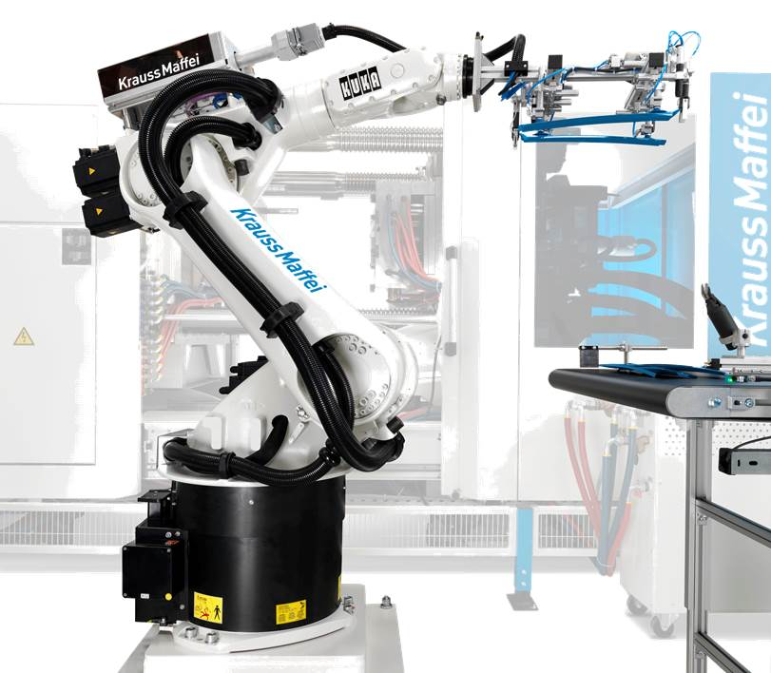
2B.) Articulated Layout: Floor, Shelf, or Clamp Mounting ?
Considerations:
Minimize stroke & floor space requirements
Maximize part harvesting time:
Try to position articulated robots to allow for the fastest part harvesting and minimal mold open requirement
Maximize post molding value added processes
Floor Mount
Shelf Mount
Clamp Mount

Slide 7
3.) Pick & Place OR Automated Cell ?
Pick & Place: Stack-Up of Tolerance Loose:
Typically has a broad allowance of tolerances
Can use robots standard position tolerance
Does not affect overall part assembly tolerance
Automated Cell: Stack-Up of Tolerance Tight:
Typically demands minimal allowance of tolerances
Should NOT rely solely on robots position tolerance
Definitely affects overall part assembly tolerance
ISOLATE Robot & IMM from stack-up of tolerances

Slide 8
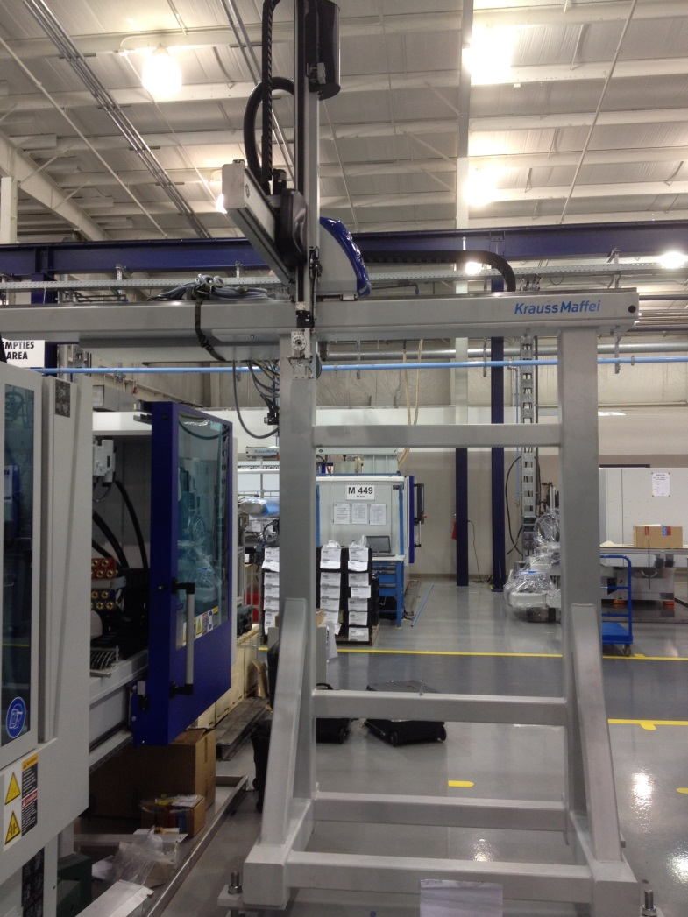
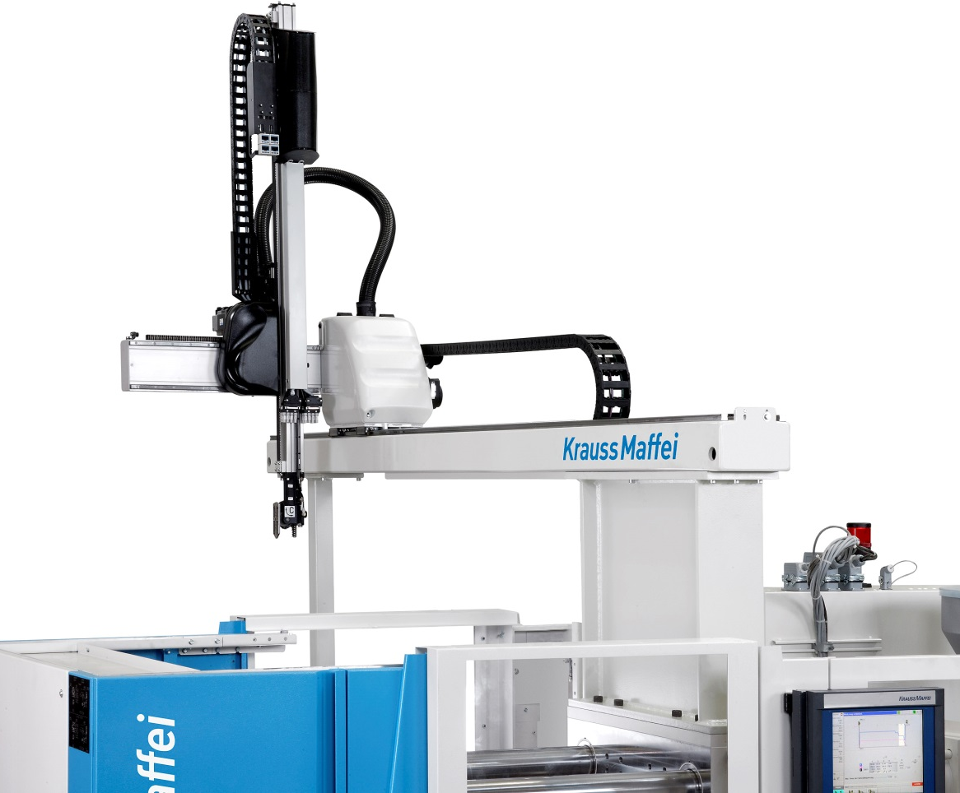
4.) Minimize vibration to maximize tolerance control
Ground vibration to the floor – just like electricity !!
Use more mass to dissipate more vibration
Isolate robot & automation from vibration when necessary

Slide 9
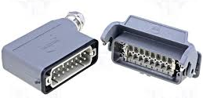
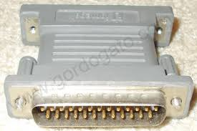
5.) Poke Yoke the system when possible
Add mold coding
Add End-of-Arm Tool coding
Code End-of-Arm to Mold with 24v signal to IMM to “Goof Proof”
EOAT Coding Connector
Mold Coding Connector

Slide 10
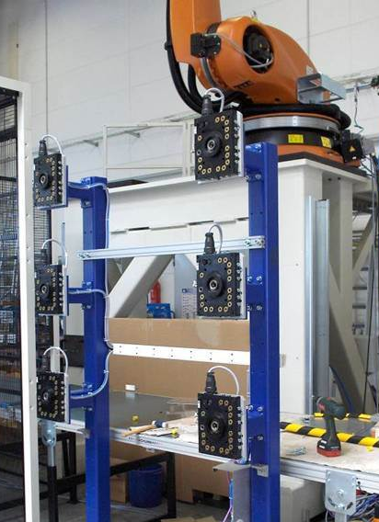
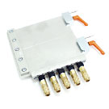
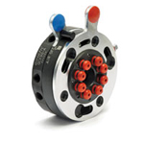
6.) Use Quick Change EOAT Mounting to simplify
Minimizes wear & tear on robot mounting surfaces
Standardizes vacuum & gripper mapping
Provides a safe means of hanging EOAT’s for storage
Makes for faster job changes
EOA Tool Tree Storage
Dovetail Quick Change
Auto Quick Change

Slide 11
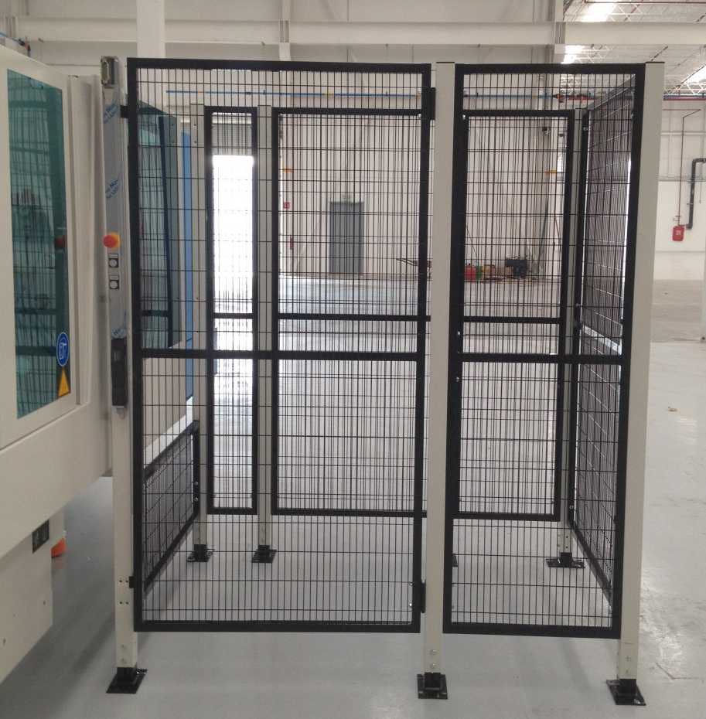
7.) Guarding Properly
Know your current OSHA / ANSI standard – check latest version
Must prevent physical entry unless properly interlocked
Must prevent accidental entry under normal conditions
Isle ways need Overhead Protection

Slide 12
Questions ?

Slide 13
Thank You!

